Slide 1



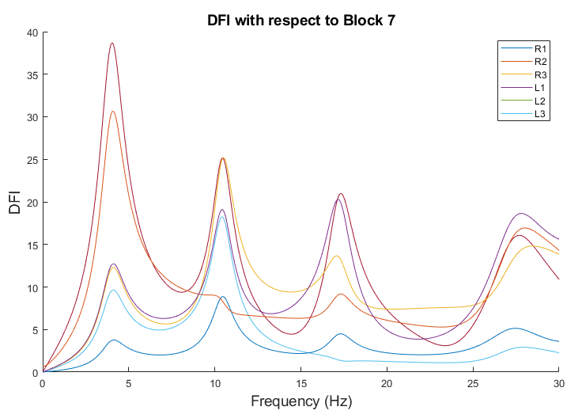
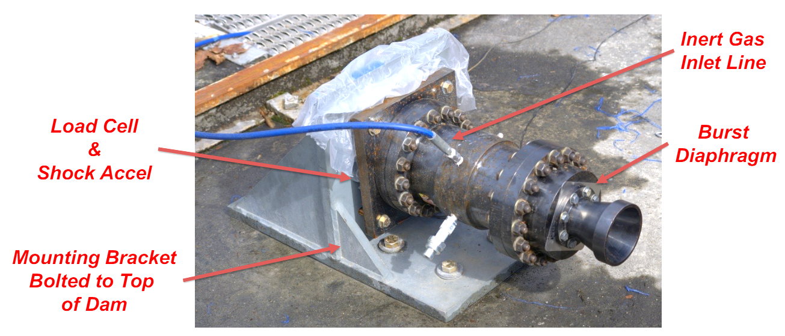
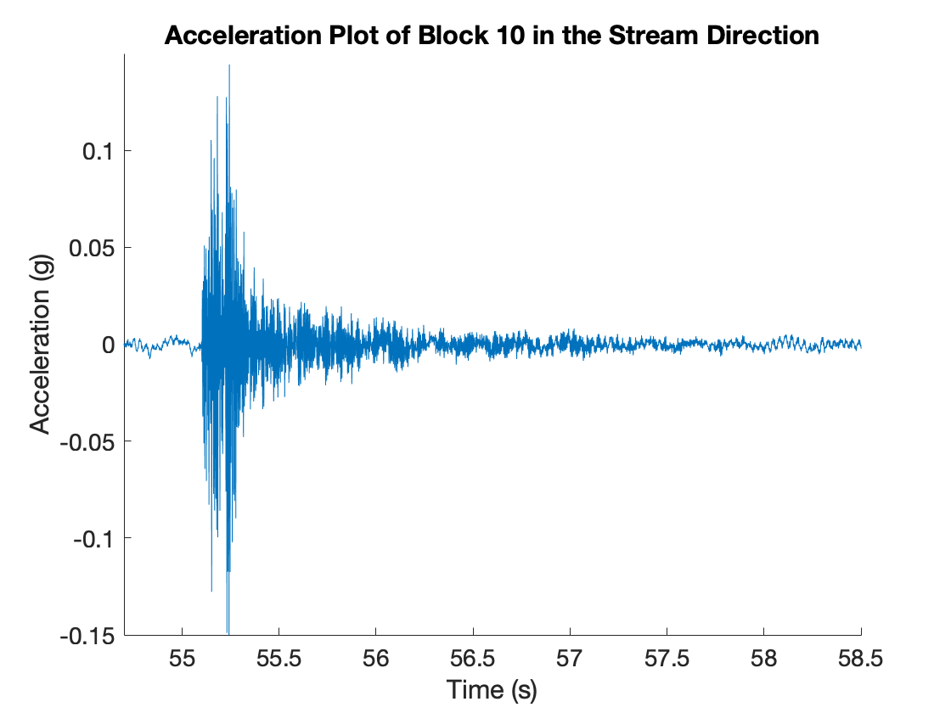
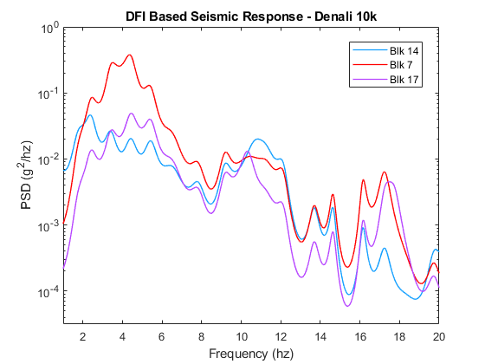

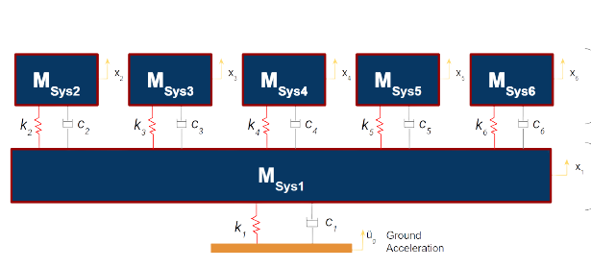
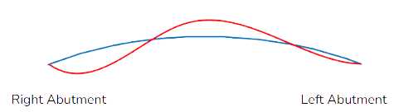
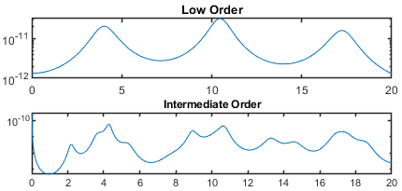
Characterizing Dam-Foundation Interactions and Assessing Dam Vibrations Through Performance Data in Large Concrete Dams
Diana Contreras, Sidney Chenevert, Andres Sanchez, Kylee Graper, and Heather Fuentes
Professor Ziyad Duron, Advisor
BACKGROUND
The De Pietro Fellowship in Civil Engineering uses Performance Based Testing (PBT) to evaluate large concrete dams. Dynamics and systems techniques are used to analyze the results and provide recommendations to owners for operation and provide seismic response predictions. In the summer of 2022, the Fellows focused their efforts on Mossyrock Dam in Mossyrock, WA.
DAM FOUNDATION INTERACTIONS AND SEISMIC DISPLACEMENTS
Two points on a dam can be represented by a Frequency Response Function (FRF). Using an input along the foundation interface of the dam and an output on the center of the crest, a dam-foundation interaction (DFI) indicator is created, as seen in Fig. 7.
Figure 7– Dam-Foundation Interactions and their Respective Amplifications
Synthetic earthquake records were used along with the DFIs to predict acceleration response. Displacements can be seen in Fig. 8. These predicted responses compare favorably with a response from an actual seismic event recorded on site.
EXPERIMENTAL PROCEDURE
The Cold Gas Thruster (CGT) in Fig. 1 provides a high amplitude, short duration, broadband frequency impulse load to the dam.
Accelerometers placed on the face of the dam capture the 3-D transient response, sampled at 10,000 Hz. Sensors on the CGT allow for monitoring repeatability of test blasts.
Figure 1 – CGT Mounted at Mossyrock Dam
Figure 8– Dam-Foundation Interactions Based Earthquake Displacements
Figure 2 – Transient Response from the Crest along Mossyrock Dam
THEORY AND ANALYSIS
Using a systems approach, the complex geology of the dam’s foundation can be characterized through a behavioral model. Behavior models, as seen in Fig. 3, can capture dominant characteristics and representing the frequency behavior.
By creating a Power Spectral Density (PSD), which relates power to frequency and leveraging performance data,various levels of analysis can be conducted. Specifically, modal responses, spectral behavior, dam-reservoir interactions, dam-foundation interactions, spillway-pier system characterization, embankment behavior, and thrust block interactions were characterized.
EMBANKMENT TESTING AND BEHAVIOR
Testing procedures were developed to be
able to apply our performance-based
evaluation techniques to the embankment
section of the dam. As such, five placement
locations were developed, with four-foot
steel rods being driven into the ground with
level metal plates being attached. Data
acquisition similar to that of other areas
was achieved, with data showing energy
dissipation into the embankment sections.
Further development of embankment
procedures is necessary, but two things are certain: performance based evaluation methods can be applied to embankment sections of dams, and during a large loading event, the embankment section would absorb much of the energy dissipated.
Figure 3 – Behavior Model for a Systems Based Approach to Model Dominant Characteristics
CREST BEHAVIORS AND INTERACTIONS
Spectral responses were found by investigating the PSDs of all blocks. As such, the fundamental modal shape of the dam was characterized, as seen in Fig. 4.
Different orders of spectral resolution allowed for the characterization of component-to-component interactions and component-to-dam interactions, allowing for the full analysis of dam-reservoir interactions and interactions from the spillway-pier system, seen in Fig. 5. These analysis led to amplification and displacement measurements.
VALUE ADDED
As America’s infrastructure ages, assessing the condition of large structures such as dams is more important than ever. Our research allows dam owners and regulators to assess seismic risk for a dam based on experimental data rather than computational finite element models (FEMs). The combination of PBT and a system’s perspectives allows the analyst to have a better understanding of the dam’s behavior, resulting in better confidence on interpreting and predicting future behavior. In addition, PBT can be conducted periodically and the results can be monitored to provide insight into the dam’s condition over time.
Figure 4 – Fundamental Modal Shape for Mossyrock Dam
ACKNOWLEDGMENTS
Tacoma Power
Gannett Fleming
California Department of Water Resources
Dr. Robert Hall and Guy Lund
De Pietro Fellowship
Department of Engineering, Harvey Mudd College
Figure 5 – Spectral Resolution Analysis
Notes:
The DFI indicator describes how inputs from the foundation are amplified or attenuated by the dam. Spectral algebra allows for the DFI indicator between input point i and output point k to be expressed as:
DFI indicators for both sides can then be calculated and compared as shown below in Fig. 4; note the left side of the dam has a much larger magnitude at low frequencies, indicating greater amplification.

